Slide 1
16-bit microprocessor design
Group 8
SAMUEL DANIEL UDEH | 3558718
KINGSLEY OWUSU SARKODIE | 3558818
TAKYI PRINCE KWAKU | 3559318
NATHANIEL AWONU OFORI | 3550118
APPIAGYEI EUGENE ADOM | 3548818
JAMES ASIAMAH | 3549818

Slide 2
CONTENT
OVERVIEW OF OUR MICROPROCESSOR
THE INSTRUCTION CYCLE
THE INSTRUCTION SET ARCHITECTURE (ISA)
HOW OUR 16-BIT MICROPROCESSOR WORKS USING LOGISM

Slide 3
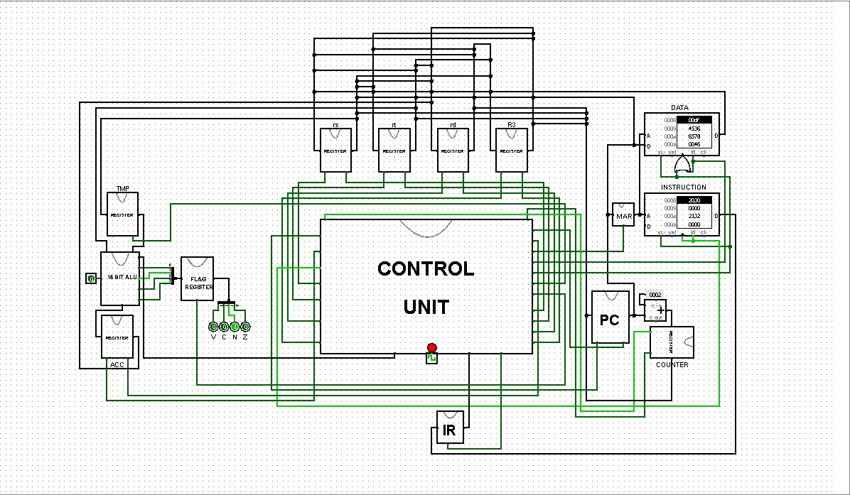
Overview of our 16-bit microprocessor

Slide 4
Overview of our 16-bit microprocessor (CONT’D)
THE REGISTERS
THE ARITHMETIC AND LOGIC UNIT (ALU)
THE CONTROL UNIT
THE RAM

Slide 5
THE REGISTERS
INSTRUCTION REGISTER
PROGRAM COUNTER
MEMORY ADDRESS REGISTER
ACCUMULATOR
GENERAL PURPOSE REGISTERS
FLAG REGISTER
TEMPORARY REGISTER

Slide 6
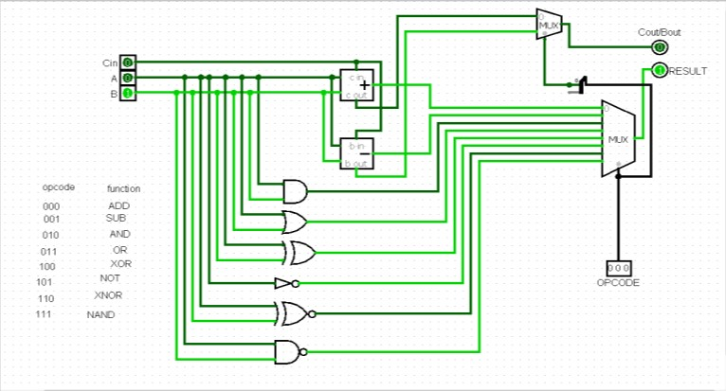
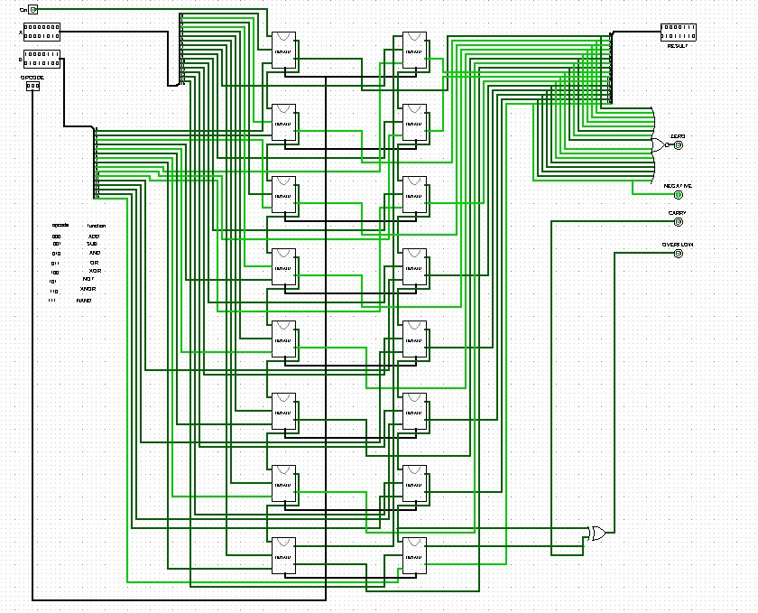
THE ARITHMETIC AND LOGIC UNIT

Slide 7
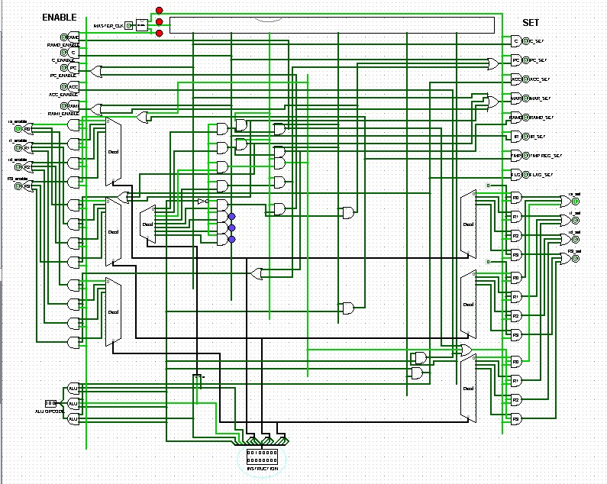
THE CONTROL UNIT

Slide 8
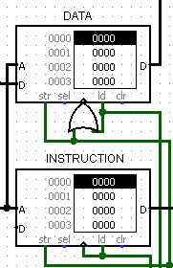
THE RAM

Slide 9
THE INSTRUCTION CYCLE
FETCH
DECODE
EXECUTE

Slide 10
THE INSTRUCTION SET ARCHITECTURE (ISA)
REGISTER NAME | USAGE | VALUE ASSIGNED
rs | General purpose | 0000
rt | General purpose | 0001
rd | General purpose | 0010
R3 | General purpose | 0011
INSTRUCTION TYPE | INSTRUCTION | OPCODE
Arithmetic | ADD | 1000
 | SUB | 1001
Logic | AND | 1010
 | OR | 1011
 | XOR | 1100
 | NOT | 1101
 | XNOR | 1110
 | NAND | 1111
Data transfer | LOAD | 0000
 | STORE | 0001
 | MOVE | 0010
Jump | JMP | 0100
 | JMPR | 0011

Slide 11
HOW OUR 16-BIT MICROPROCESSOR WORKS USING LOGISM

Slide 12
THANK YOU
ANY QUESTION ?

